Slide 1
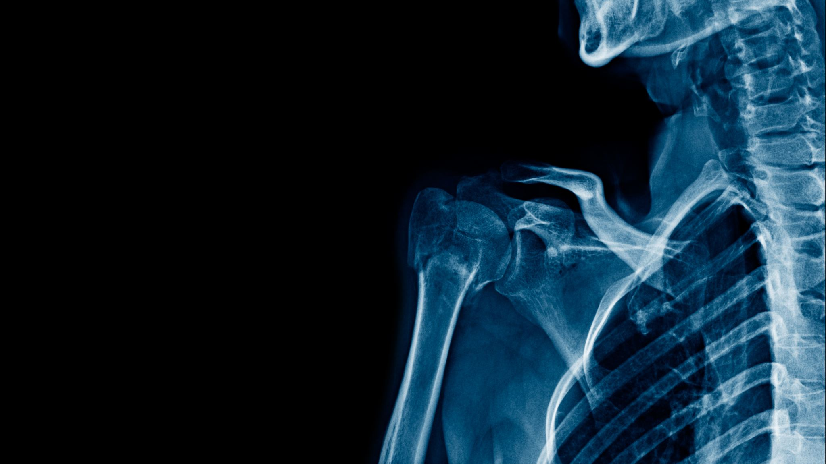
X-Ray Segmentation and Classification
Daniyal Ahmed (301152472)
Vikas Trivedi (301217554)
Kanishka Dhir ()

Slide 2
Introduction
Critical need for diagnostic tools during the COVID-19 epidemic.
Utilizing Deep Learning for COVID-19 detection from chest X-rays.
Objective: Creation and assessment of three distinct models.
Notes:
"The COVID-19 pandemic has spurred innovation in diagnostic methods, with artificial intelligence emerging as a potent tool."
"This project addresses the need by creating and evaluating three models for COVID-19 detection from chest X-ray images."
"Our diverse dataset, collaboratively assembled, includes cases of viral pneumonia, non-COVID lung infections, COVID-19 positives, and normal cases [1]."

Slide 3
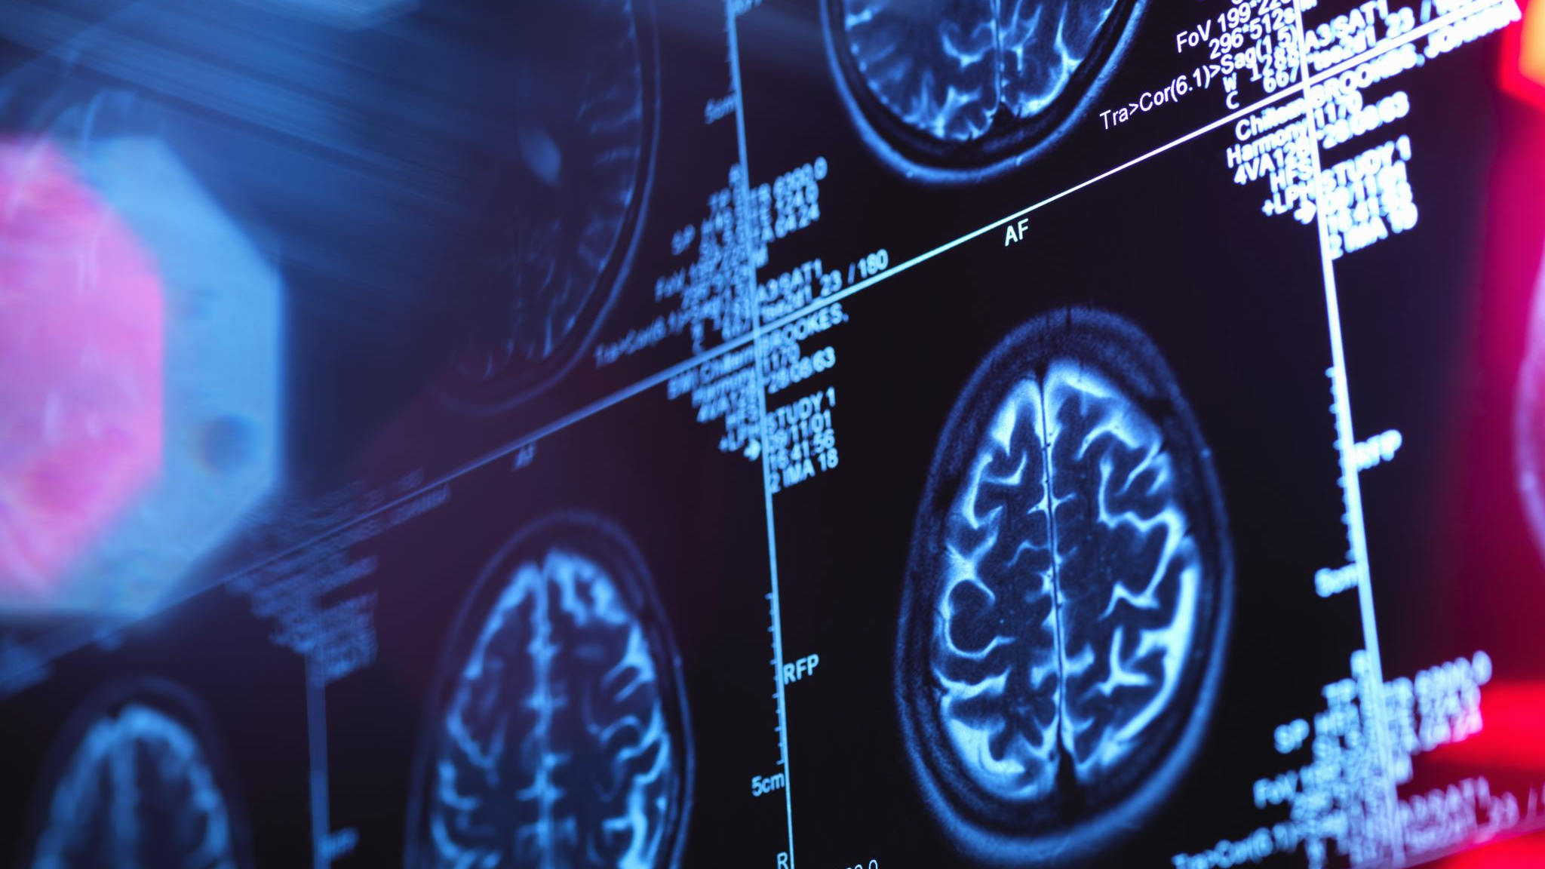
Problem Description & Scope
The critical need for novel diagnostic tools during the COVID-19 epidemic prompted the use of Deep Learning in this project.
Objective: Develop effective models for COVID-19 detection from chest X-ray images
Dataset: Comprehensive, covering various cases to ensure robust model evaluation
Notes:
"The critical need for novel diagnostic tools during the COVID-19 epidemic prompted the use of Deep Learning in this project."
"Objective: Develop effective models for COVID-19 detection from chest X-ray images."
"Dataset: Comprehensive, covering various cases to ensure robust model evaluation [1]."

Slide 4
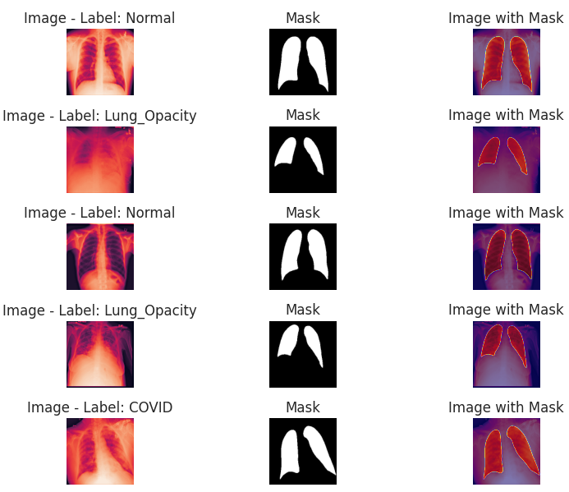
Understanding the Dataset
The dataset is a comprehensive collection of chest X-ray images."
Diversity in cases includes instances of viral pneumonia, non-COVID lung infections, confirmed COVID-19 cases, and normal cases.
This diverse dataset ensures a robust evaluation of our models across various diagnostic scenarios.
Notes:
"Our dataset, assembled through cooperative efforts, is a comprehensive collection of chest X-ray images."
"Diversity in cases includes instances of viral pneumonia, non-COVID lung infections, confirmed COVID-19 cases, and normal cases."
"This diverse dataset ensures a robust evaluation of our models across various diagnostic scenarios."

Slide 5

Methodology
Three distinct models were employed for COVID-19 detection: Simple CNN Classification, U2-Net for Segmentation and Classification, and EfficientNetB0 for Classification.
Notes:
Three distinct models were employed for COVID-19 detection: Simple CNN Classification, U2-Net for Segmentation and Classification, and EfficientNetB0 for Classification.
Each model addresses the problem using different architectures and approaches.
This section provides a detailed exploration of the methodologies employed.

Slide 6
Data Pre-processing
Resizing images ensures a uniform dimensionality, while normalization standardizes pixel values for consistent analysis
Data augmentation techniques, such as rotation and horizontal flipping, are employed
Notes:
"Before model training, the dataset undergoes careful preprocessing steps."
"Resizing images ensures a uniform dimensionality, while normalization standardizes pixel values for consistent analysis."
"Data augmentation techniques, such as rotation and horizontal flipping, are employed to enhance the models’ generalization skills."

Slide 7
Model 1 - Simple CNN Classification
Leverages a Simple Convolutional Neural Network (CNN) for image classification
Consists of multiple convolutional layers, max-pooling layers, and dropout layers for regularization
The Rectified Linear Unit (ReLU) activation function introduces non-linearity, and the final layer includes a softmax activation for multi-class classification."
Notes:
"Our first model leverages a Simple Convolutional Neural Network (CNN) for image classification [3]."
"The architecture consists of multiple convolutional layers for feature extraction, max-pooling layers for spatial downsampling, and dropout layers for regularization."
"The Rectified Linear Unit (ReLU) activation function introduces non-linearity, and the final layer includes a softmax activation for multi-class classification."

Slide 8
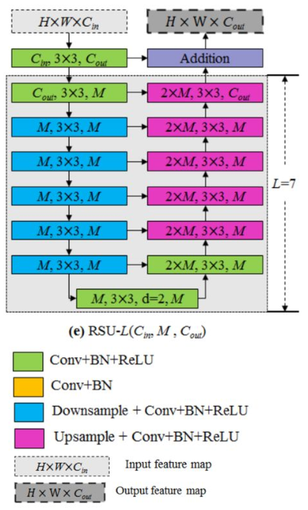
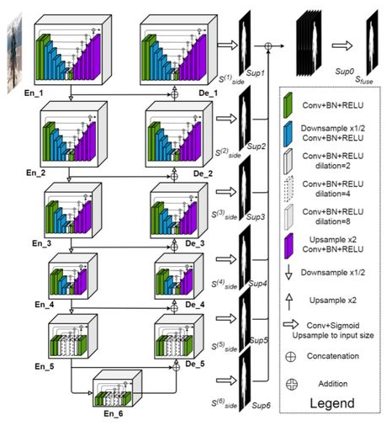
Model 2 - U2-Net for Segmentation and Classification
Adopts the U2-Net architecture, specifically designed for biomedical image segmentation
Key features include Recursive Supervision Units (RSU) working in a recursive fashion, extracting hierarchical features for nuanced pattern recognition.
Skip connections enhance the model's design, allowing the smooth transmission of critical features across layers
Notes:
"Model 2 adopts the U2-Net architecture, specifically designed for biomedical image segmentation [4]."
"Key features include Recursive Supervision Units (RSU) working in a recursive fashion, extracting hierarchical features for nuanced pattern recognition."
"Skip connections enhance the model's design, allowing the smooth transmission of critical features across layers."

Slide 9
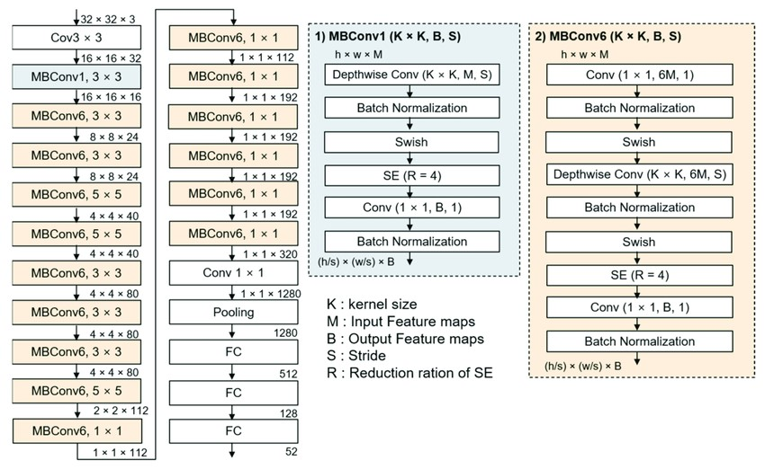
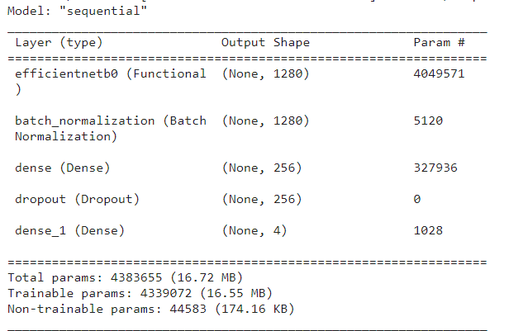
Model 3 - EfficientNetB0 for Classification
A pillar of the EfficientNet family, proves useful in various computer vision applications
Scales the depth, width, and resolution for optimal performance.
Incorporates depth-wise separable convolution, reducing parameters and processing cost for efficiency.
Notes:
EfficientNetB0, a pillar of the EfficientNet family, proves useful in various computer vision applications, including COVID-19 identification via chest X-ray analysis [5]."
"Compound scaling is key, simultaneously scaling the depth, width, and resolution for optimal performance."
"The architecture incorporates depth-wise separable convolution, reducing parameters and processing cost for efficiency."

Slide 10
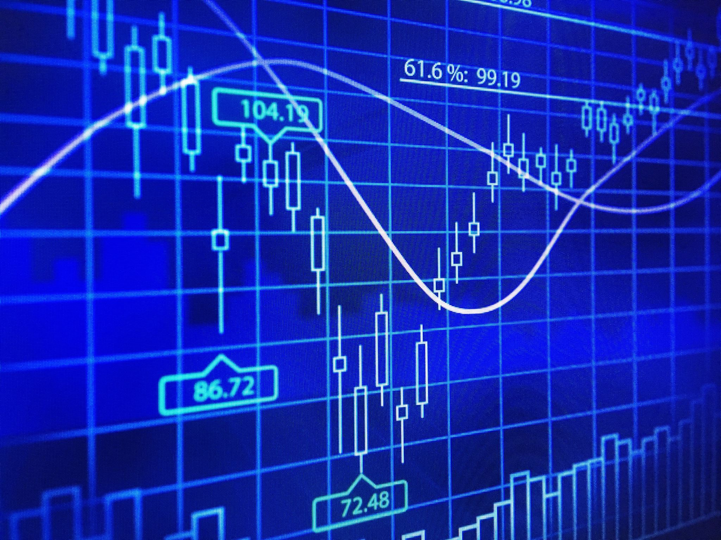
Results & Analysis

Slide 11
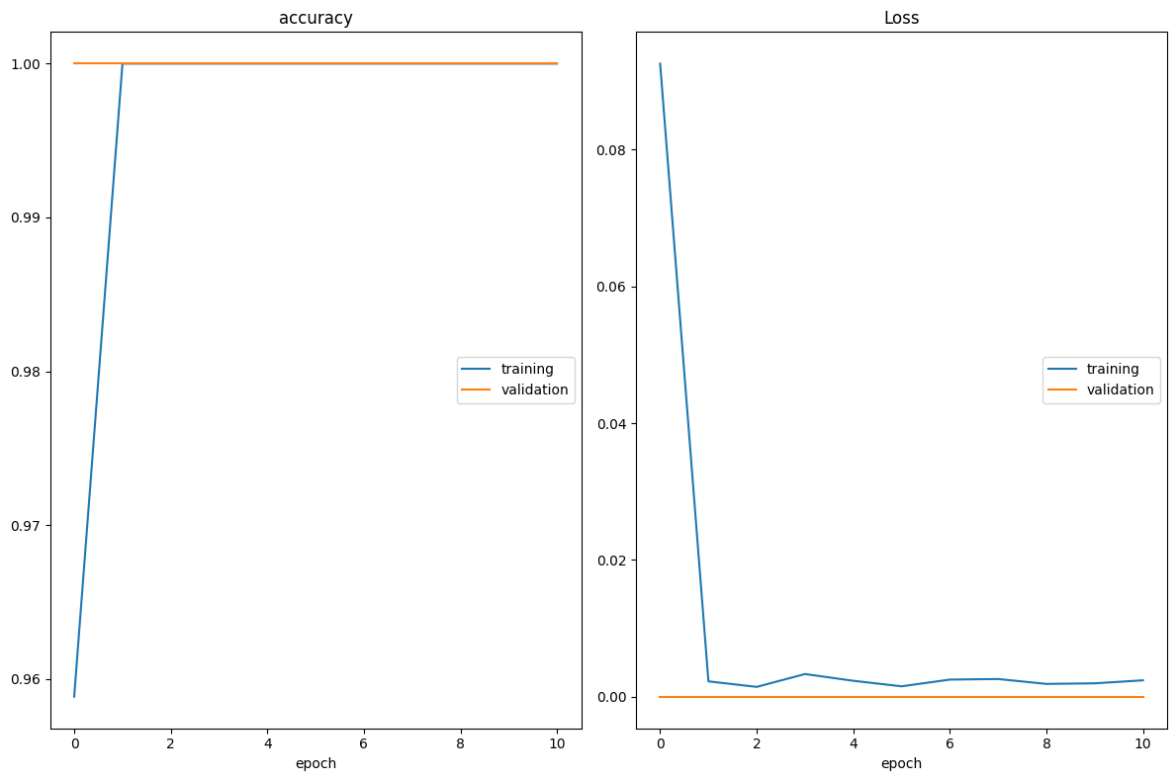
Results: Simple CNN
Achieved 100% accuracy on training and validation sets, indicating sub-optimal performance.
Low loss values suggest learning some dataset patterns, but overfitting is a concern.
Further exploration with subsequent models needed for comprehensive assessment.
Notes:
Achieved 100% accuracy on training and validation sets, indicating sub-optimal performance.
Low loss values suggest learning some dataset patterns, but overfitting is a concern.
Urgent need for closer examination of generalization capabilities.
100% accuracy after the first epoch implies heavy overfitting, questioning true pattern learning.
Further exploration with subsequent models recommended for comprehensive assessment.

Slide 12
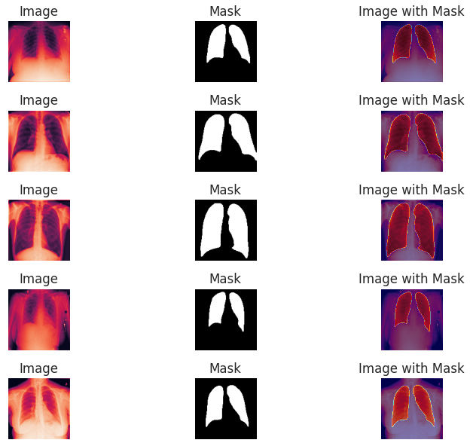
Results: U2-Net
Commendable performance with an accuracy of 71.88%
Segmentation pinpointed specific regions of interest, enhancing classification
Moderate accuracy implies potential difficulties, prompting investigation into misclassifications
Notes:
Demonstrated a commendable performance with an accuracy of 71.88%.
Segmentation capability pinpointed specific regions of interest, enhancing classification sophistication (see Fig. 4).
Room for improvement highlighted in results, necessitating a closer examination of optimization strategies.
Segmentation feature enhances model interpretability by emphasizing critical regions for classification.
Moderate accuracy implies potential difficulties, prompting investigation into misclassifications.

Slide 13
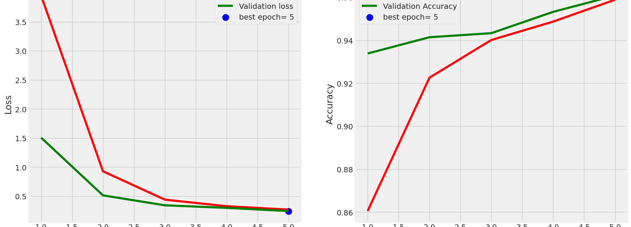
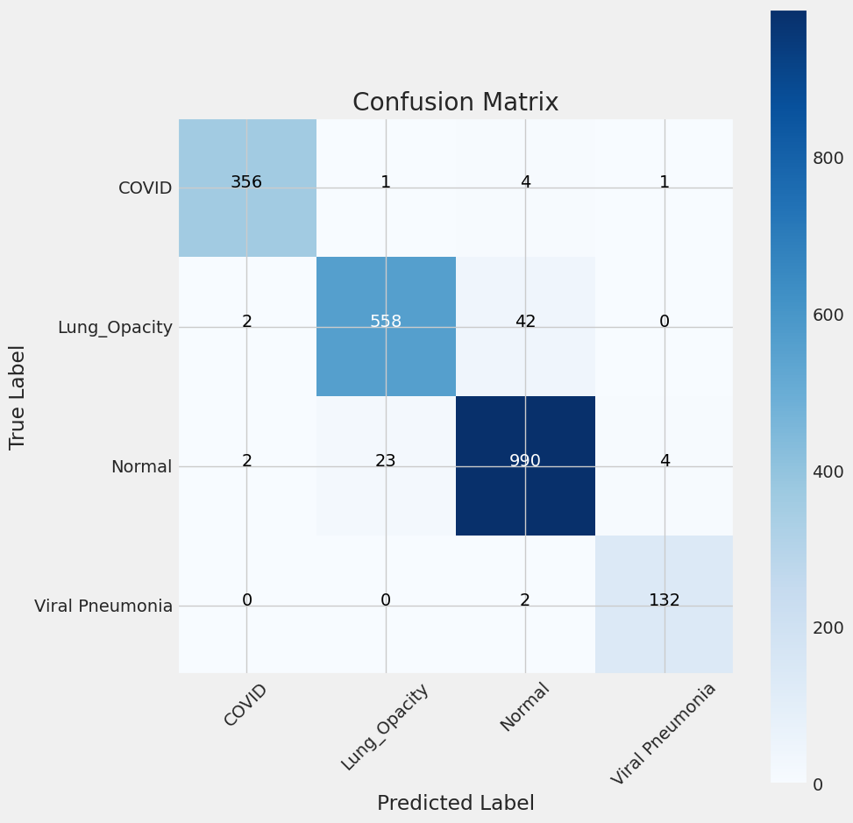
Results: EfficientNet B0
Admirable performance with 97.41% accuracy on the training set and 96.77% on the validation set and 96.17% accuracy on testing data
Confusion matrix showcased strong capacity for class distinction
Despite early stopping, demonstrated an impressive ability to generalize to new data.
Notes:
Achieved admirable performance with 97.41% accuracy on the training set and 96.77% on the validation set.
Confusion matrix showcased strong capacity for class distinction, with good precision and recall values.
Exceptional classification performance underscored the significance of efficient architectures in medical image processing.
Despite early stopping, demonstrated an impressive ability to generalize to new data.
Suggested exploration of interpretability techniques for insights into decision-making processes.
Potential enhancement of diagnostic skills by gaining deeper understanding of correct predictions.

Slide 14

Technical Challenges
EfficientNet B0 used 3 hours to train 5 epochs
Building U2Net Model from scratch
Adjusting classification layers and callbacks after training U2Net

Slide 15
Thank you!

